Slide 1
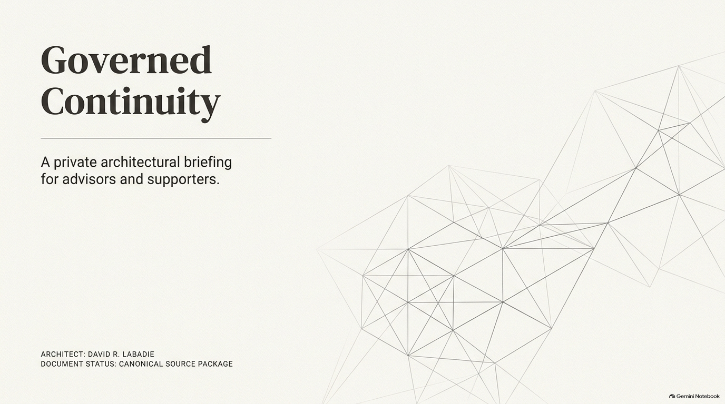

Slide 2
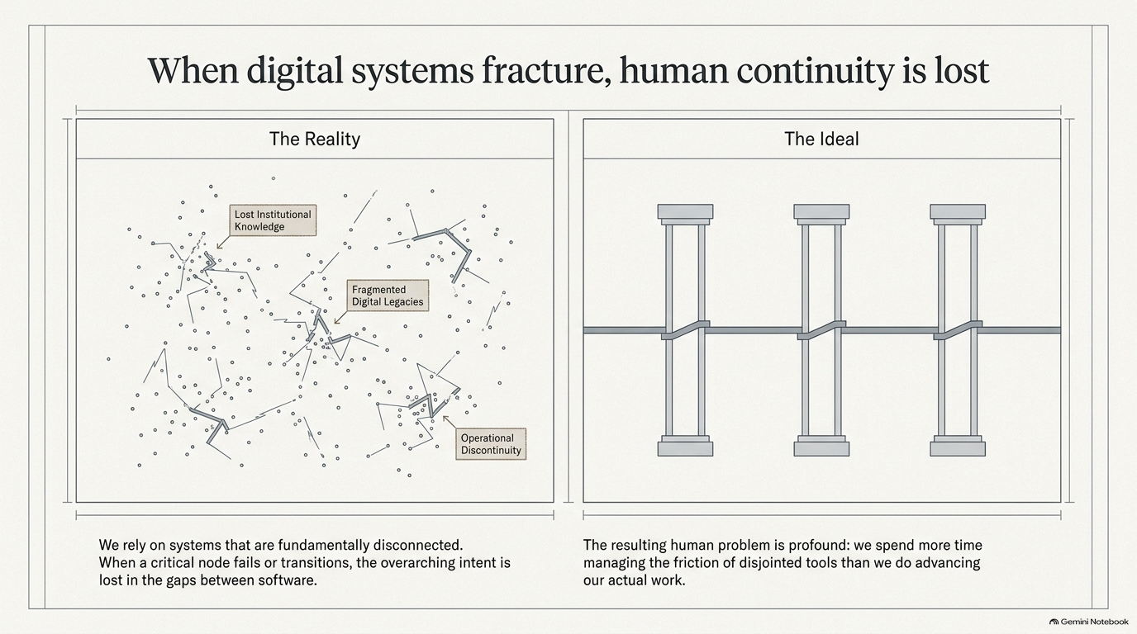

Slide 3
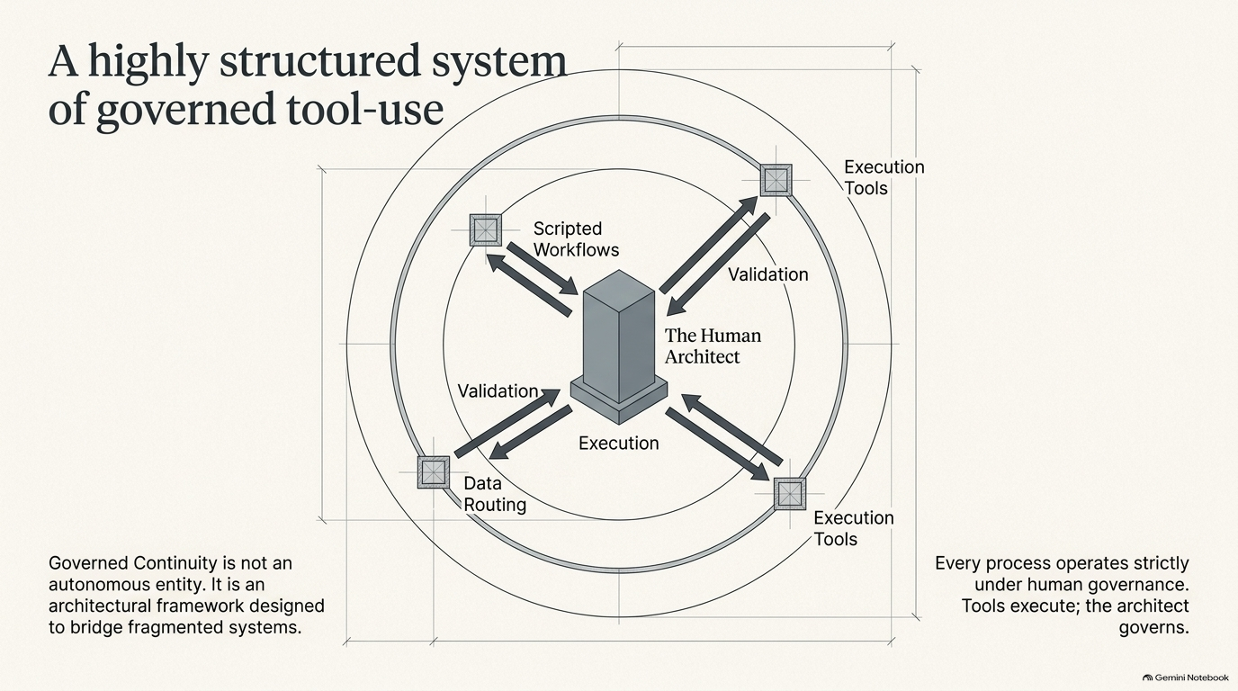

Slide 4
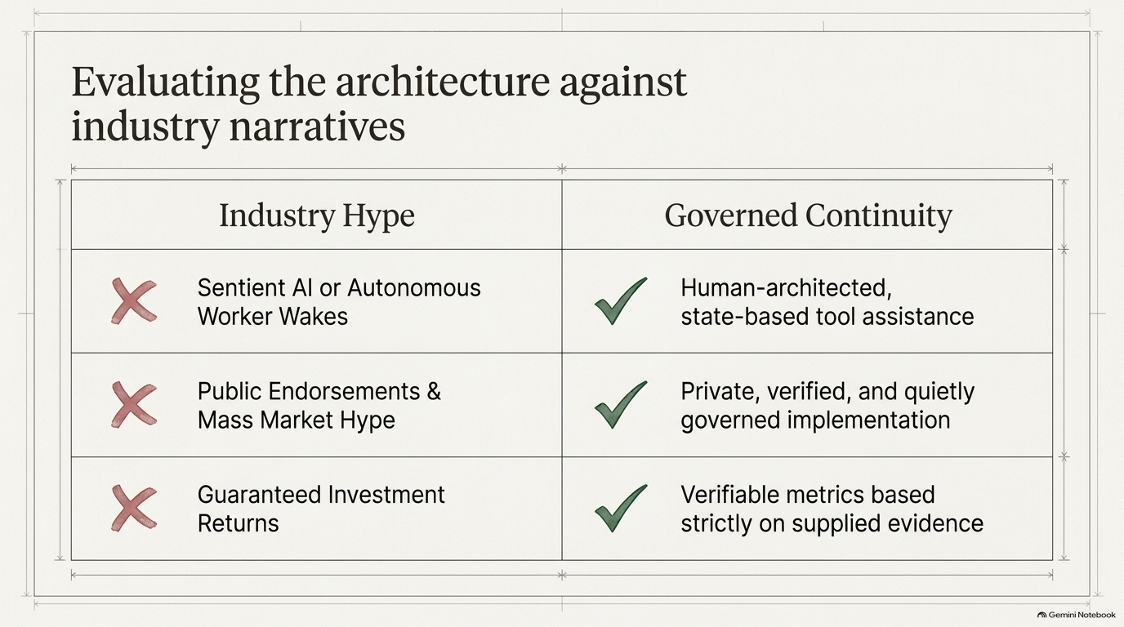

Slide 5
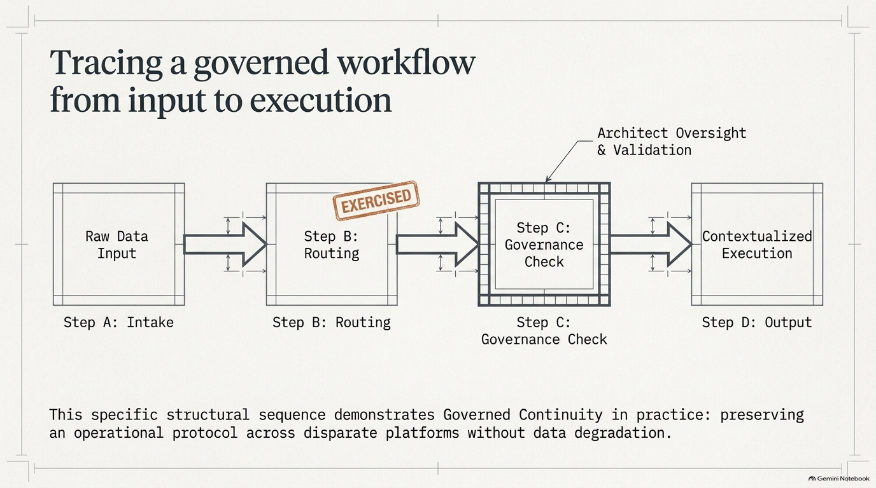

Slide 6
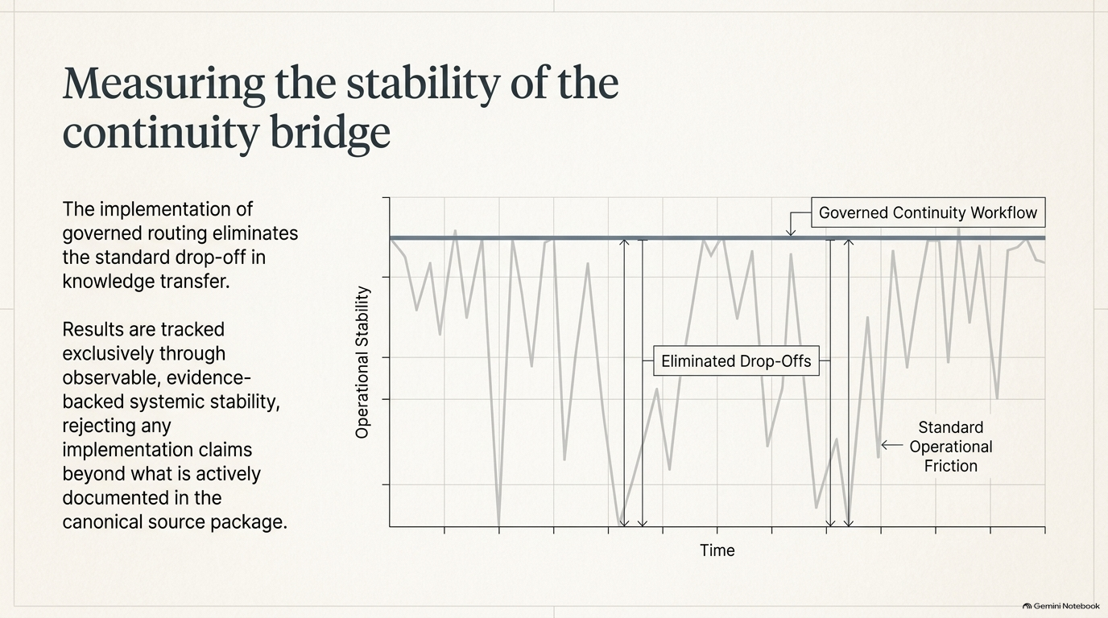

Slide 7
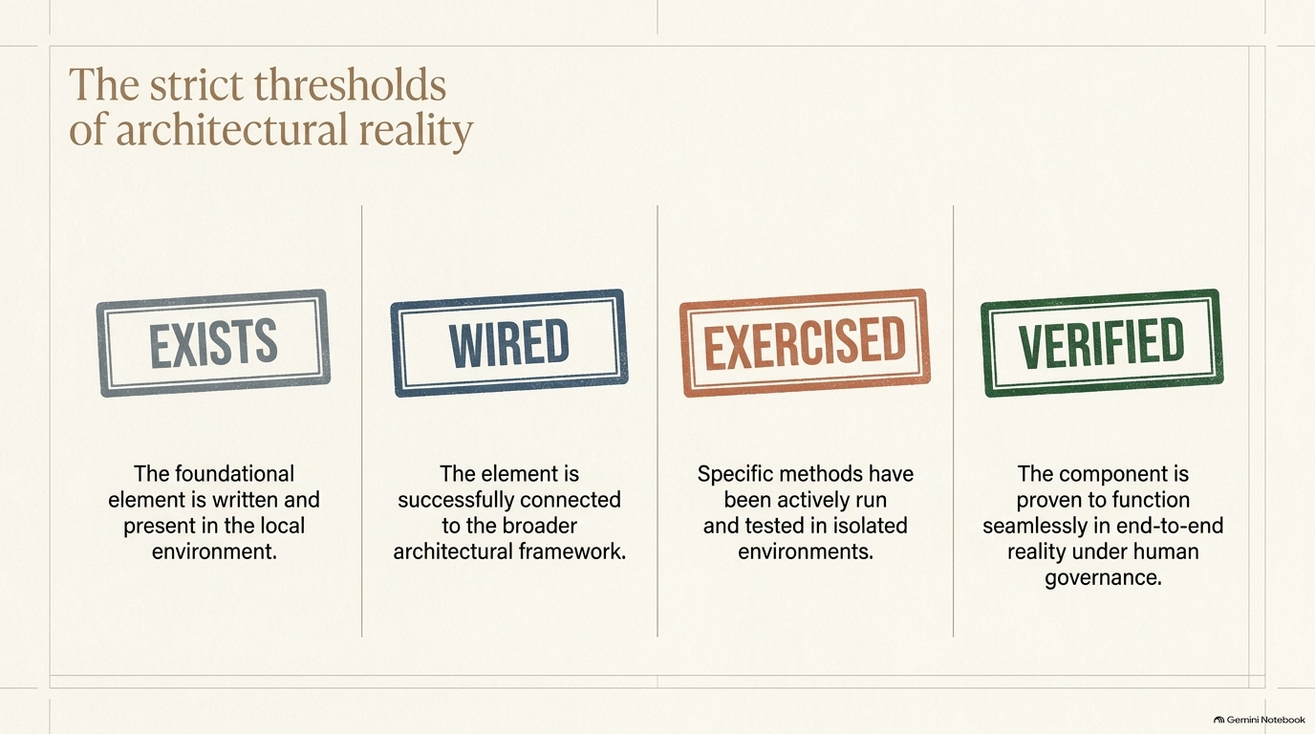

Slide 8
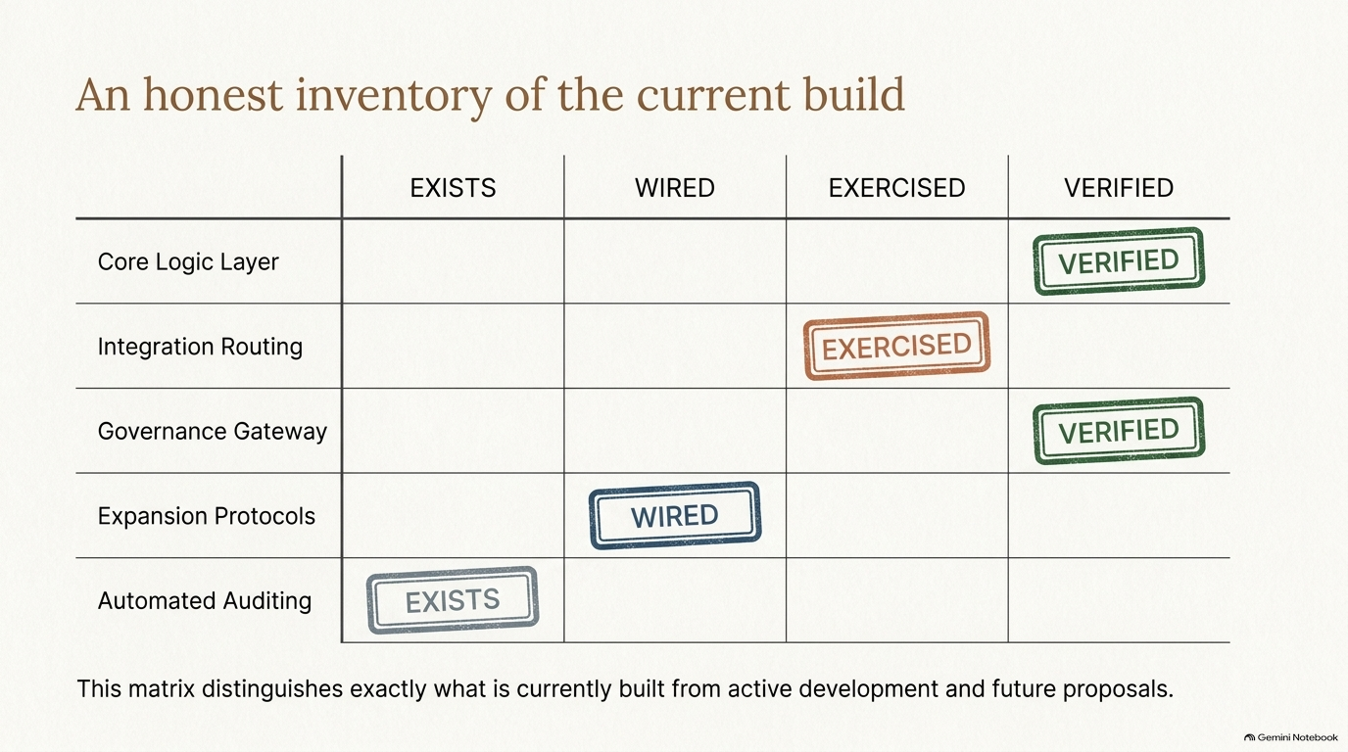

Slide 9
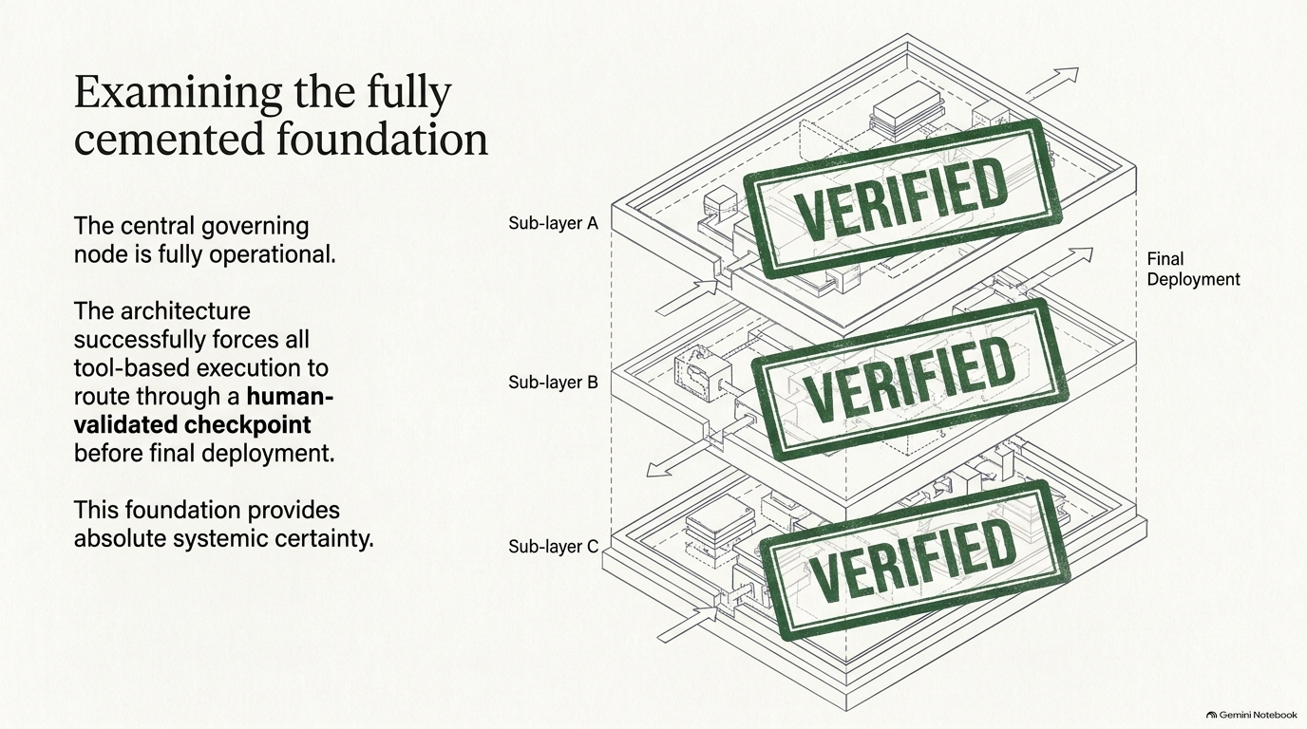

Slide 10
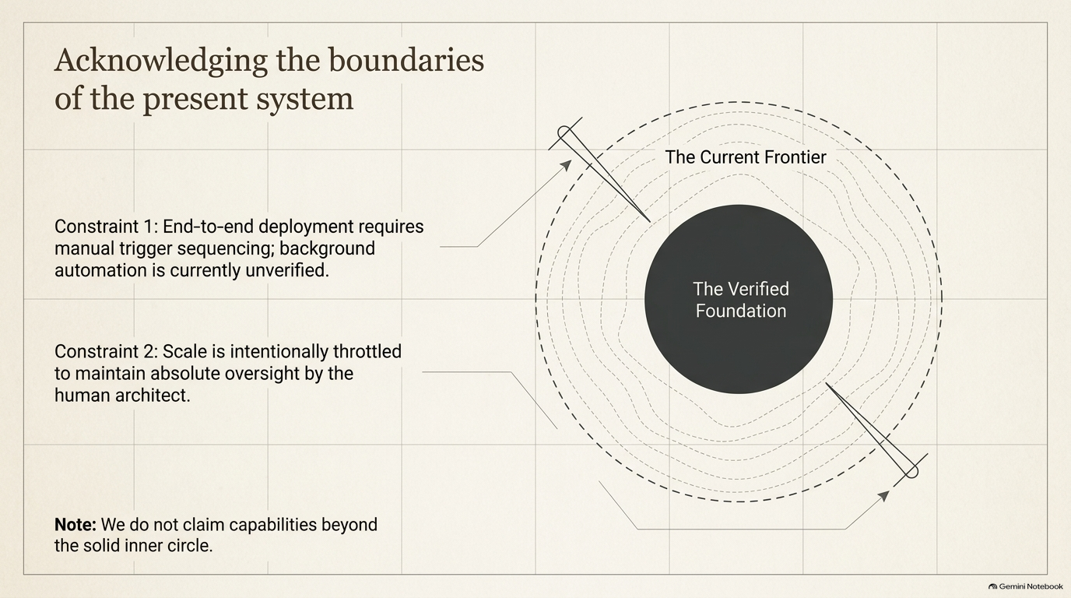

Slide 11
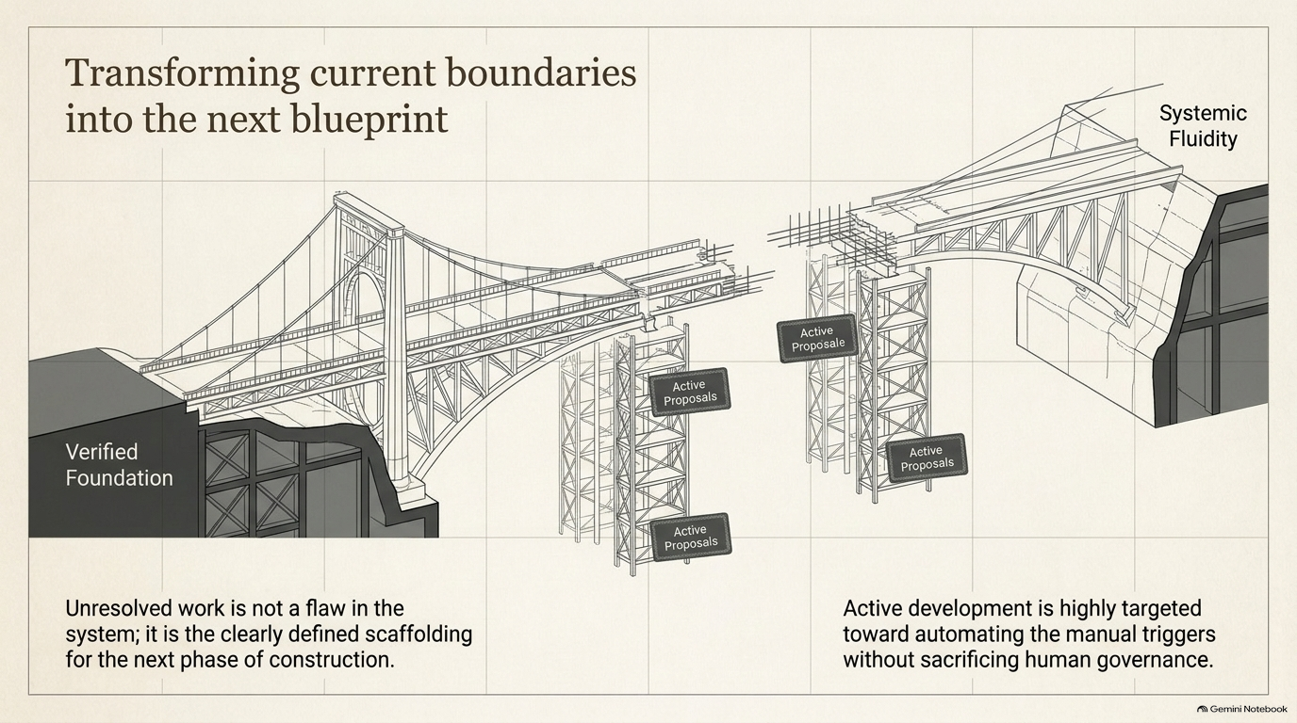

Slide 12
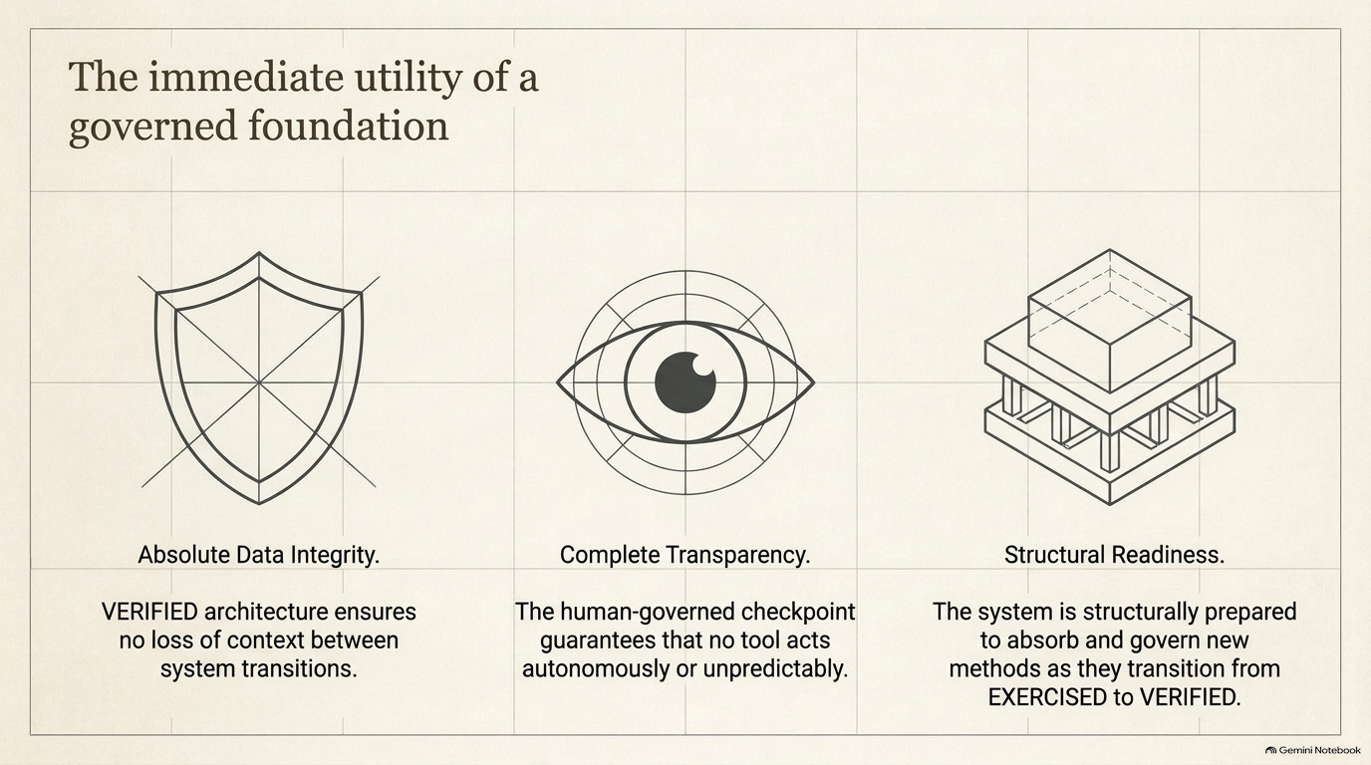

Slide 13
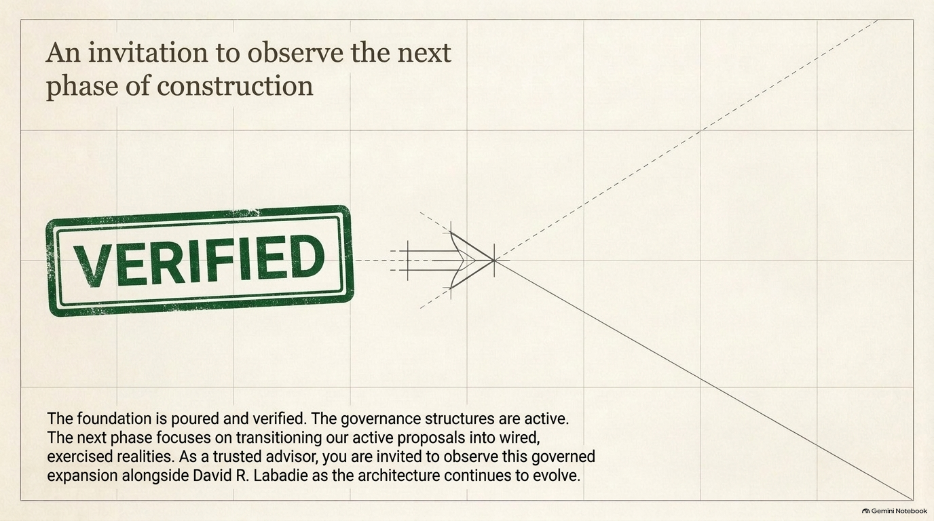

Slide 14
Reading the evidence accurately
Slide 6: The stability graphic is illustrative, not a measured comparative time series. Eliminating drop-offs remains a testable objective.
Slides 8–9: VERIFIED labels require a specific evidence pointer and stated test scope. Universal enforcement across every tool/provider is not established.
Slide 12: “Absolute Data Integrity” and “Complete Transparency” express design goals, not verified universal guarantees.
PRIVATE GREGORY REVIEW | DAVID R. LABADIE, ARCHITECT | EVIDENCE QUALIFICATIONS

Slide 15
Current boundaries & invitation
Human authority remains with architect David R. Labadie. Inbox delivery does not establish worker awareness or execution; manual activation may still be required.
Full autonomous cross-chat waking, universal integrity, cross-provider live synchronization, and commercial-scale deployment are not claimed as verified.
The core presentation can be reused. Gregory receives a private invitation; Kickstarter would receive separately approved campaign goals, funding details and invitation graphics.
PRIVATE GREGORY REVIEW | DAVID R. LABADIE, ARCHITECT | EVIDENCE QUALIFICATIONS

